Slide 1
C# Features
Lead Trainer
Batch 1 : Mihir Soni
Batch 2 : Hiral Savaria
Lab Mentor
Batch 1 : Pashvin Trivedi
Batch 2 : Shardendu Kumar

Slide 2

MVC Life cycle, Features & Filters / C# Features
URL Request Flow in ASP.NET MVC
Request life cycle
Controller Events Execution
What is Ajax Request ?
Types of Ajax Requests (Get/Post)
Browser Plugins/dev tools
Filters
Areas in MVC
Action filters, OutputCache, HandleError, NonAction, Authorize
Routing
C# Features
Data Types, Constants & readonly
Generics
Linq Operations

Slide 3

MVC Request life cycle & Controller Events Execution
Ref:
https://www.tutorialspoint.com/asp.net_mvc/asp.net_mvc_life_cycle.htm
https://www.tutorialspoint.com/asp.net_mvc/asp.net_mvc_controllers.htm

Slide 4
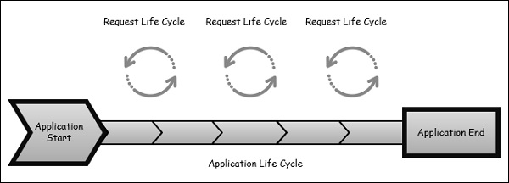
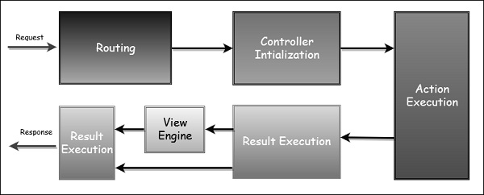
MVC Life cycle
Two life cycles :−
The Application Life Cycle
The application life cycle refers to the time at which the application process actually begins running IIS until the time it stops. This is marked by the application start and end events in the startup file of your application.
The Request Life Cycle
It is the sequence of events that happen every time an HTTP request is handled by our application.
The entry point for every MVC application begins with routing. After the ASP.NET platform has received a request, it figures out how it should be handled through the URL Routing Module.
Modules are .NET components that can hook into the application life cycle and add functionality. The routing module is responsible for matching the incoming URL to routes that we define in our application.
All routes have an associated route handler with them and this is the entry point to the MVC framework.
The MVC framework handles converting the route data into a concrete controller that can handle requests. After the controller has been created, the next major step is Action Execution. A component called the action invoker finds and selects an appropriate Action method to invoke the controller.

Slide 5
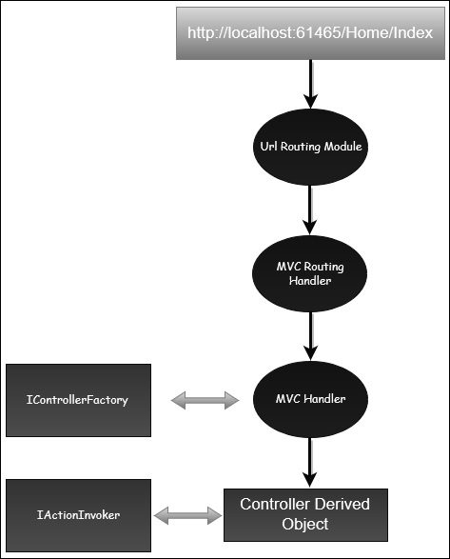
Controller Events Execution
What is Controller?
Controllers are essentially the central unit of your ASP.NET MVC application. It is the first recipient, which interacts with incoming HTTP Request. So, the controller decides which model will be selected, and then it takes the data from the model and passes the same to the respective view, after that view is rendered. Controllers are controlling the overall flow of the application taking the input and rendering the proper output.
Event Execution
ASP.NET MVC Action Methods are responsible to execute requests and generate responses to it. By default, it generates a response in the form of ActionResult. Actions typically have a one-to-one mapping with user interactions.
Request Processing
UrlRoutingModule - that inspects and understands that something configured within the routing table knows how to handle that URL.
UrlRoutingModule to Routing table - hands over control to the MVC route handler.
MVC route passes the controller over to the MvcHandler - which is an HTTP handler.
MvcHandler - to instantiate the controller (it looks in the RouteData for that controller value).
Controller Execution - that's been derived from the MVC's controller base class.
Action Invoker - The Execute method creates an action invoker and tells that action invoker to go and find a method to invoke, find an action to invoke.
The action invoker, again, looks in the RouteData and finds that Action Parameter that's been passed along from the routing engine.
Ref:
https://www.tutorialspoint.com/asp.net_mvc/asp.net_mvc_controllers.htm

Slide 6
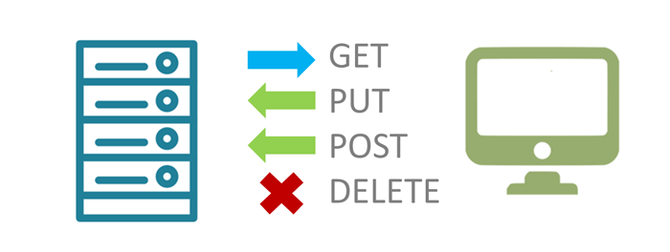
Ajax Request & Types
Ref:
https://www.w3schools.com/jquery/jquery_ajax_intro.asp
https://www.w3schools.com/jquery/jquery_ajax_get_post.asp

Slide 7
Ajax Request & Types of Ajax Requests
What is AJAX?
AJAX = Asynchronous JavaScript and XML.
AJAX is about loading data in the background and display it on the webpage, without reloading the whole page
What About jQuery and AJAX?
jQuery provides several methods for AJAX functionality.
With the jQuery AJAX methods, you can request text, HTML, XML, or JSON from a remote server using both HTTP Get and HTTP Post - And you can load the external data directly into the selected HTML elements of your web page!
Without jQuery, AJAX coding can be a bit tricky.
AJAX code can be a bit tricky, because different browsers have different syntax for AJAX implementation. This means that you will have to write extra code to test for different browsers.
However, the jQuery team has taken care of this for us, so that we can write AJAX functionality with only one single line of code.
Benefits of Ajax
Callbacks
Making Asynchronous Calls
User-Friendly
Improve the speed, performance and usability of a web application

Slide 8
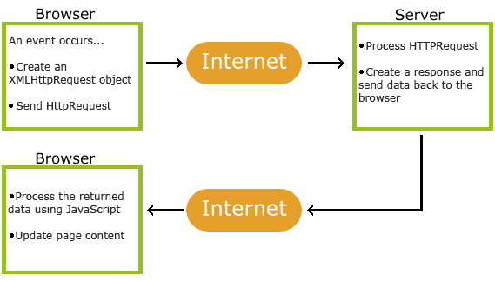
Ajax Request & Types of Ajax Requests
How AJAX Works
An event occurs in a web page (the page is loaded, a button is clicked)
An XMLHttpRequest object is created by JavaScript
The XMLHttpRequest object sends a request to a web server
The server processes the request
The server sends a response back to the web page
The response is read by JavaScript
Proper action (like page update) is performed by JavaScript
<script src="https://code.jquery.com/jquery-{version}.min.js"></script>

Slide 9
AJAX get() and post() Methods
The jQuery get() and post() methods are used to request data from the server with an HTTP GET or POST request. Two commonly used methods for a request-response between a client and server are:
GET - Requests data from a specified resource. GET is basically used for just getting (retrieving) some data from the server. Note: The GET method may return cached data.
POST - Submits data to be processed to a specified resource. POST can also be used to get some data from the server. However, the POST method NEVER caches data, and is often used to send data along with the request.
jQuery $.get() Method
Syntax: $.get(URL, callback);
URL - parameter specifies the URL you wish to request. (Required)
callback - parameter is the name of a function to be executed if the request succeeds. (Optional)
Example
$("button").click(function(){
$.get("demo_test.asp", function(data, status){
alert("Data: " + data + "\nStatus: " + status);
});
});
The first parameter of $.get() is the URL we wish to request ("demo_test.asp").
The second parameter is a callback function. The first callback parameter holds the content of the page requested, and the second callback parameter holds the status of the request.

Slide 10
AJAX get() and post() Methods
jQuery $. post() Method
Syntax: $.post(URL, data, callback);
URL - parameter specifies the URL you wish to request. (Required).
data - parameter specifies some data to send along with the request. (Optional)
callback - parameter is the name of a function to be executed if the request succeeds. (Optional)
Example
$("button").click(function(){
$.post("demo_test_post.asp",
{
name: "Donald Duck",
city: "Duckburg"
},
function(data, status){
alert("Data: " + data + "\nStatus: " + status);
}
);
});
The first parameter of $.post() is the URL we wish to request ("demo_test_post.asp").
Then we pass in some data to send along with the request (name and city). The ASP script in "demo_test_post.asp" reads the parameters, processes them, and returns a result.
The second parameter is a callback function. The first callback parameter holds the content of the page requested, and the second callback parameter holds the status of the request.
Ref :
https://www.w3schools.com/jquery/jquery_ajax_get_post.asp

Slide 11

Browser Plugins & Dev tools
Ref:
https://developer.chrome.com/extensions/devtools
https://developer.chrome.com/devtools/docs/integrating

Slide 12
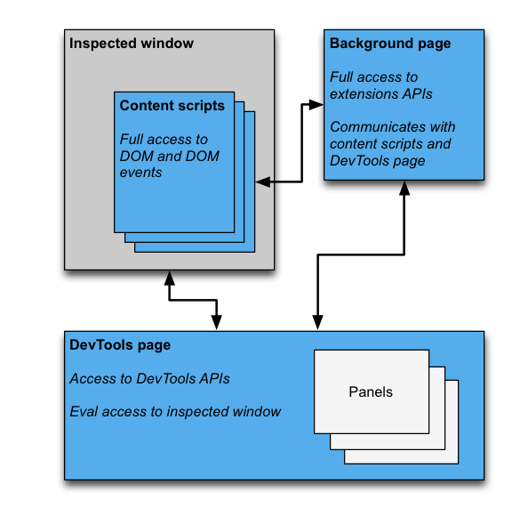
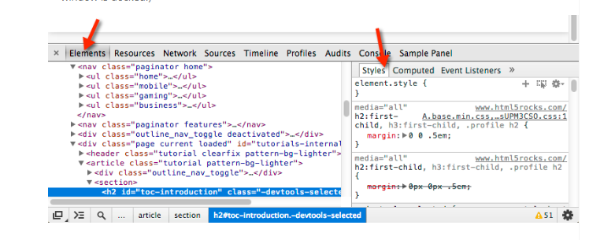
Overview
A DevTools extension adds functionality to the Chrome DevTools. It can add new UI panels and sidebars, interact with the inspected page, get information about network requests, and more. View featured DevTools extensions. DevTools extensions have access to an additional set of DevTools-specific extension APIs:
devtools.inspectedWindow
devtoots.network
devtools.panels
A DevTools extension is structured like any other extension: it can have a background page, content scripts, and other items. In addition, each DevTools extension has a DevTools page, which has access to the DevTools APIs.
DevTools UI Elements: Panels and Sidebar Panes

Slide 13

Areas in MVC & Filters (Action Filters)
Ref:
https://www.tutorialsteacher.com/mvc/area-in-asp.net-mvc
https://www.tutorialsteacher.com/mvc/action-filters-in-mvc
https://www.tutorialspoint.com/asp.net_mvc/asp.net_mvc_filters.htm

Slide 14
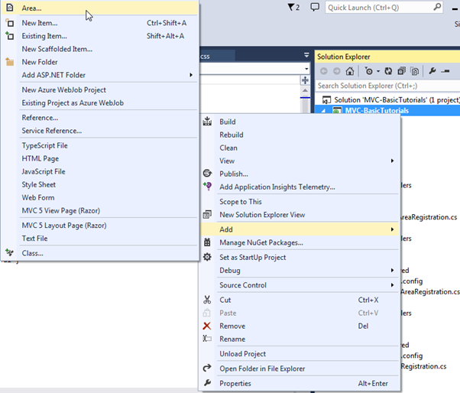
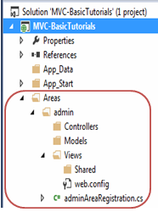
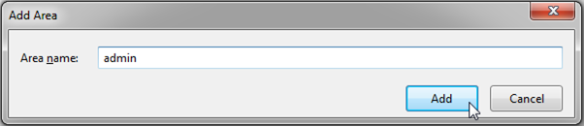
Area in MVC
Area
You have already learned that ASP.NET MVC framework includes separate folders for Model, View and Controller.
However, large application can include a large number of controller, views and model classes. So to maintain a large number of views, models and controllers with the default ASP.NET MVC project structure can become Unmanageable.
ASP.NET MVC 2 introduced Area. Area allows us to partition large application into smaller units where each unit contains separate MVC folder structure, same as default MVC folder structure.
For example, large enterprise application may have different modules like admin, finance, HR, marketing etc. So an Area can contain separate MVC folder structure for all these modules
You can create an Area using ASP.NET MVC 5 and Visual Studio 2013 for web by right clicking on the project in the solution explorer -> Add -> Area..

Slide 15
Area in MVC
As you can see, each area includes AreaRegistration class in {area name} + AreaRegistration.cs file.
The following is adminAreaRegistration class created with admin area.
AreaRegistration class overrides RegisterArea method to map the routes for the area. In the above example, any URL that starts with admin will be handled by the controllers included in the admin folder structure under Area folder.
For Ex. http://localhost/admin/profile will be handled by profile controller included in Areas/admin/controller/ProfileController folder.
Finally, all the area must be registered in Application_Start event in Global.asax.cs as AreaRegistration.RegisterAllAreas(); So in this way, you can create and maintain multiple areas for the large application.
Area Registration:
public class adminAreaRegistration : AreaRegistration
{
public override string AreaName
{
get
{
return "admin";
}
}
public override void RegisterArea(AreaRegistrationContext context)
{
context.MapRoute(
"admin_default",
"admin/{controller}/{action}/{id}",
new { action = "Index", id = UrlParameter.Optional }
);
}
}

Slide 16
Actions - Filters
ASP.NET MVC Action Methods are responsible to execute requests and generate responses to it.
By default, it generates a response in the form of ActionResult. Actions typically have a one-to-one mapping with user interactions.
Types of Action
Actions basically return different types of action results. The ActionResult class is the base for all action results
Sr.No. | Name and Behavior
1 | ContentResult Returns a string
2 | FileContentResult Returns file content
3 | FilePathResult Returns file content
4 | FileStreamResult Returns file content
5 | EmptyResult Returns nothing
6 | JavaScriptResult Returns script for execution
7 | JsonResult Returns JSON formatted data
8 | RedirectToResult Redirects to the specified URL
9 | HttpUnauthorizedResult Returns 403 HTTP Status code
10 | RedirectToRouteResult Redirects to different action/different controller action
11 | ViewResult Received as a response for view engine
12 | PartialViewResult Received as a response for view engine
using System.Web.Mvc;
namespace TestProject.Controllers
{
public class HomeController : Controller
{
public ActionResult Index()
{
ViewBag.Title = "Home Page";
return View();
}
}
public JsonResult GetItemDetail(int id)
{
return Json(new { message = "OK" }, JsonRequestBehavior.AllowGet);
}
}

Slide 17
Actions - Filters
Action Filters
In ASP.NET MVC, controllers define action methods that usually have a one-to-one relationship with possible user interactions, but sometimes you want to perform logic either before an action method is called or after an action method runs.
To support this, ASP.NET MVC provides filters. Filters are custom classes that provide both a declarative and programmatic means to add pre-action and post-action behavior to controller action methods.
An action filter is an attribute that you can apply to a controller action or an entire controller that modifies the way in which the action is executed. The ASP.NET MVC framework includes several action filters −
OutputCache − Caches the output of a controller action for a specified
amount of time.
HandleError − Handles errors raised when a controller action is executed.
Authorize − Enables you to restrict access to a particular user or role.
Types of Filters
Authorization Filters − Implements the IAuthorizationFilter attribute.
Action Filters − Implements the IActionFilter attribute.
Result Filters − Implements the IResultFilter attribute.
Exception Filters − Implements the IExceptionFilter attribute.
Custom Filters
Apply Action Filter
using System.Web.Mvc;
namespace TestProject.Controllers
{
public class HomeController : Controller
{
[OutputCache(Duration = 20)]
public ActionResult Index()
{
return DateTime.Now.ToString("T");
}
}
}
If you refresh the browser, you will see the same time because the action is cached for 20 seconds. It will be updated when you refresh it after 20 seconds.

Slide 18
Output Cache
[OutputCache]
The output cache enables you to cache the content returned by a controller action. That way, the same content does not need to be generated each and every time the same controller action is invoked.
Output caching provides you with a very easy method of dramatically improving the performance of your ASP.NET MVC applications.
You enable output caching by adding an [OutputCache] attribute to either an individual controller action or an entire controller class.
There is no guarantee that content will be cached for the amount of time that you specify. When memory resources become low, the cache starts evicting content automatically.
By default, when you use the [OutputCache] attribute, content is cached in three locations: the web server, any proxy servers, and the web browser. You can control exactly where content is cached by modifying the Location property of the [OutputCache] attribute.
Apply OutputCache Filter
using System.Web.Mvc;
namespace TestProject.Controllers
{
public class HomeController : Controller
{
[OutputCache(Duration = 20)]
public ActionResult Index()
{
return DateTime.Now.ToString("T");
}
}
}
If you refresh the browser, you will see the same time because the action is cached for 20 seconds. It will be updated when you refresh it after 20 seconds.
https://www.tutorialsteacher.com/mvc/action-filters-in-mvc

Slide 19
Handle Error
[HandleError]
ASP.NET MVC has HandleError Attribute (Action Filter), which provides one of the simplest ways to handle errors.
HandleError Attribute has a couple of properties which are useful in handling an exception and help in modifying the default behavior of HandleError Attribute.
ExceptionType: Exception Type specifies the type of an exception. If not specified, then HandleError filter handles all the Exception.
View: Specifies the name of view to display when an exception occurs.
Master: Master specifies the name of the master view.
Order: If more than one HandleError attribute is used, then the order specifies the order of the filters applied. We can set an integer from -1 (Highest Priority) to any positive integer. If no order is specified, then the Order value is -1.
In order to use HandleError Attribute, first, we have to enable Custom Error in web.config file.
Setting HandleError Attribute as a Global Filter in Global.asax file protected void Application_Start()
{
GlobalFilters.Filters.Add(new HandleErrorAttribute());
}
Apply HandelError Filter
using System.Web.Mvc;
namespace TestProject.Controllers
{
public class HomeController : Controller
{
//If Format Exception thrown then SpecificError View is displayed
//If Divide by Zero Exception thrown then Error View is displayed
[HandleError(View = "SpecificError", ExceptionType = typeof(FormatException))]
[HandleErro(Order = 2, View = "Error", ExceptionType = typeof(DivideByZeroException))]
public ActionResult About()
{
//Throws an Exception for demonstration
throw new FormatException();
return View();
}
}
}
We can also declare HandleError attribute on the Controller level as well as on Action method. Declare HandleError attribute on an Action method.
https://www.c-sharpcorner.com/article/handleerror-action-filter-in-asp-net-mvc/

Slide 20
Non Action
[NonAction]
In ASP.NET MVC, every public method of controller is accessible via url regardless of return type, so if we have created any public method in controller which is not intended to serve as action method then also it is accessible via url.
One solution is that keep this method as private or protected but some time we need to keep this method as public. This is where NonAction attribute comes in picture
If you mark any method as NonAction and try to access that method then it will return HTTP 404 not found error.
So whenever we want to create public method in controller which is not intended for action method or in other word which is not returning Action Result those method should be marked with NonAction action method selector attribute.
NonAction is inherited from ActionMethodSelectorAttribute.
Apply NonAction Filter
using System.Web.Mvc;
namespace TestProject.Controllers
{
public class HomeController : Controller
{
//This method return the value “Test Page”
public string GetName()
{
return "Test Page";
}
//This method return HTTP 404 not found error
[NonAction]
public string GetName()
{
return "Test Page";
}
}
}
https://www.dotnetexpertguide.com/2012/10/aspnet-mvc-nonaction-action-filter.html
https://dotnettutorials.net/lesson/non-action-selector-mvc/

Slide 21
Authorize
[Authorize]
In ASP.NET MVC application, all the action methods of all controllers can be accessed by both authenticated and anonymous users. But If you want the action methods to be available only for the authenticated and authorized users, then you need to use the Authorization Filter in MVC.
The Authorization Filter provides two built-in attributes such as Authorize and AllowAnonymous which we can use as per our business requirement.
If you want the “SecureMethod” to be accessed only by the authenticated and authorized users, then you need to decorate this method with the “Authorize” attribute.
If you want to allow anonymous access to the NonSecureMethod of Home controller, then you need to decorate the AllowAnonymous attribute.
Apply Authorize Filter
using System.Web.Mvc;
namespace TestProject.Controllers
{
public class HomeController : Controller
{
[AllowAnonymous]
public ActionResult NonSecured()
{
return "Non Secured";
}
[Authorize]
public ActionResult Secured()
{
return "Secured";
}
}
}
https://www.c-sharpcorner.com/article/authorization-filter-in-asp-net-mvc/
https://dotnettutorials.net/lesson/authorization-filter-mvc/

Slide 22

Routing in MVC
Ref:
https://www.c-sharpcorner.com/UploadFile/3d39b4/routing-in-mvc/
https://exceptionnotfound.net/attribute-routing-vs-convention-routing/

Slide 23
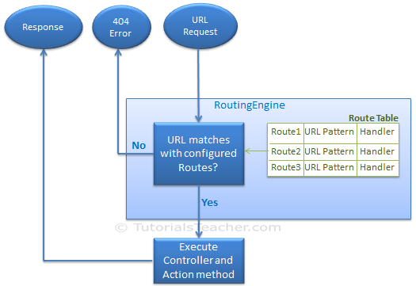
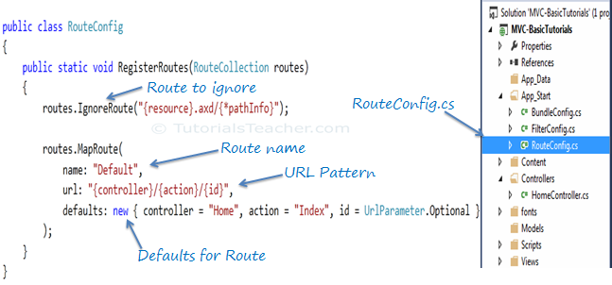
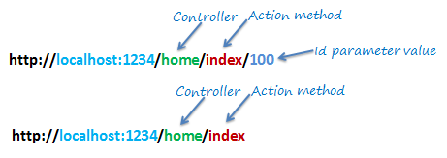
Routing in MVC
ASP.NET introduced Routing to eliminate needs of mapping each URL with a physical file. Routing enable us to define URL pattern that maps to the request handler. This request handler can be a file or class.
In ASP.NET Webform application, request handler is .aspx file and in MVC, it is Controller class and Action method. For example, http://domain/students can be mapped to http://domain/studentsinfo.aspx in ASP.NET Webforms and the same URL can be mapped to Student Controller and Index action method in MVC.
Route
Configure a Route
URL Pattern
URL pattern "{controller}/{action}/{id}" would look like localhost:1234/{controller}/{action}/{id}.
Anything after "localhost:1234/" would be considered as controller name.
The same way, anything after controller name would be considered as action name and then value of id parameter.

Slide 24
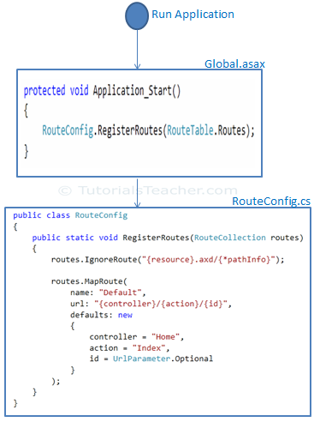
Routing Types :: Convention Routing
Multiple Routes
URL | Controller | Action | Id
http://localhost/student/123 | StudentController | Index | 123
http://localhost/student/index/123 | StudentController | Index | 123
http://localhost/student?Id=123 | StudentController | Index | 123
public static void RegisterRoutes(RouteCollection routes)
{
routes.IgnoreRoute("{resource}.axd/{*pathInfo}");
routes.MapRoute(
name: "Student",
url: "students/{id}",
defaults: new { controller = "Student", action = "Index"}
);
routes.MapRoute(
name: "Default",
url: "{controller}/{action}/{id}",
defaults: new { controller = "Home", action = "Index", id = UrlParameter.Optional }
);
}
Register Routes
public class MvcApplication : System.Web.HttpApplication
{
protected void Application_Start()
{
RouteConfig.RegisterRoutes(RouteTable.Routes);
}
}
Route Constraints
routes.MapRoute(
name: "Student",
url: "student/{id}/{name}/{standardId}",
defaults: new { controller = "Student", action = "Index", id = UrlParameter.Optional, name = UrlParameter.Optional, standardId = UrlParameter.Optional },
constraints: new { id = @"\d+" }
);

Slide 25
Routing Types :: Attribute Routing
Attribute Routing (introduced in MVC 5) is the ability to add routes to the Route Table via attributes so that the route definitions are in close proximity to their corresponding actions. We will still populate the Route Table, but we will do it in a different manner.
public class RouteConfig
{
public static void RegisterRoutes(RouteCollection routes)
{
routes.IgnoreRoute("{resource}.axd/{*pathInfo}");
routes.MapMvcAttributeRoutes(); //Enables Attribute Routing
}
}
Enable Attribute Routing
If you want to use Attribute Routing, you have to enable it by calling MapMvcAttributeRoutes on the RouteCollection for your app (usually this is done in RouteConfig)
Example
Parameters
public class HomeController : Controller
{
[Route("Users/Index")] //Route: /Users/Index
public ActionResult Index() { ... }
}
What that [Route] attribute does is specify a route to be added to the Route Table which maps to this action.
[Route("Users/{id}")] //Route: /Users/12
public ActionResult Details(int id) { ... }
[Route("Users/{id}/{name?}")] //Route: /Users/12/Matthew-Jones or /Users/12
public ActionResult Details(int id, string name) { ... }
We can also specify if a parameter is optional by using ?
[Route("Users/{id:int}")] //Route: /Users/12
public ActionResult Details(int id) { ... }
If we need a given parameter to be of a certain type, we can specify a constraint
Route Prefixes
[RoutePrefix("Users")]
public class HomeController : Controller
{
[Route("{id}")] //Route: /Users/12
public ActionResult Details(int id) { ... }
}
We can specify a RoutePrefix that applies to every action in a controller. If we need to have an action that overrides the Route Prefix, we can do so using the absolute-path prefix ~/
Ref :
https://exceptionnotfound.net/attribute-routing-vs-convention-routing/

Slide 26
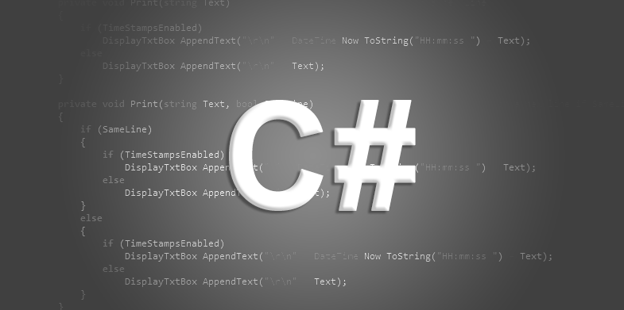
C# Features
(Data Types, Constants & readonly, Generics, Linq)

Slide 27
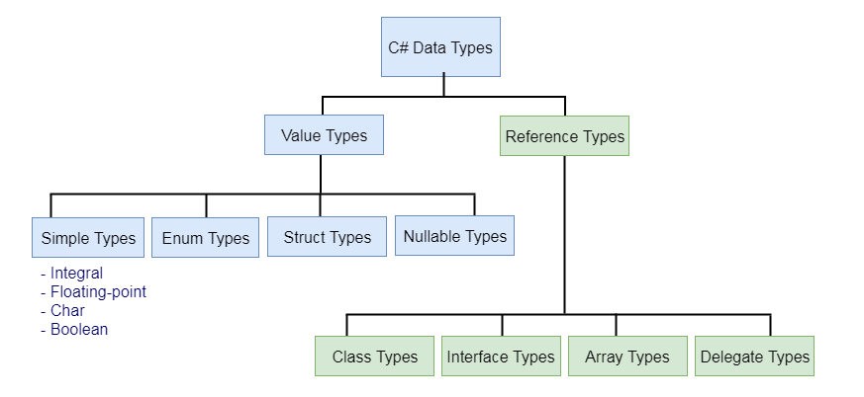
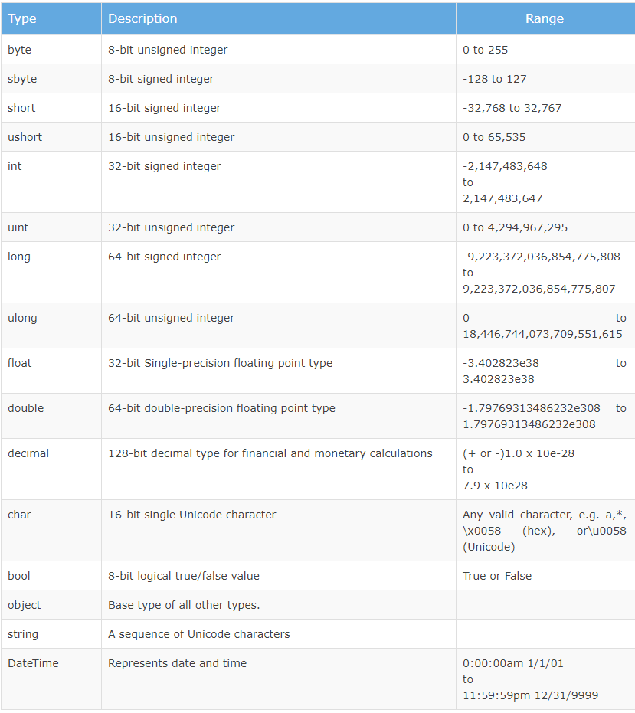
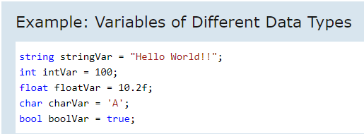
Data Types
C# is a strongly-typed language. It means we must declare the type of a variable which indicates the kind of values it is going to store such as integer, float, decimal, text, etc.
C# mainly categorized data types in two types: Value types and Reference types. Value types include simple types (e.g. int, float, bool, and char), enum types, struct types, and Nullable value types. Reference types include class types, interface types, delegate types, and array types.
Predefined Data Types in C#

Slide 28
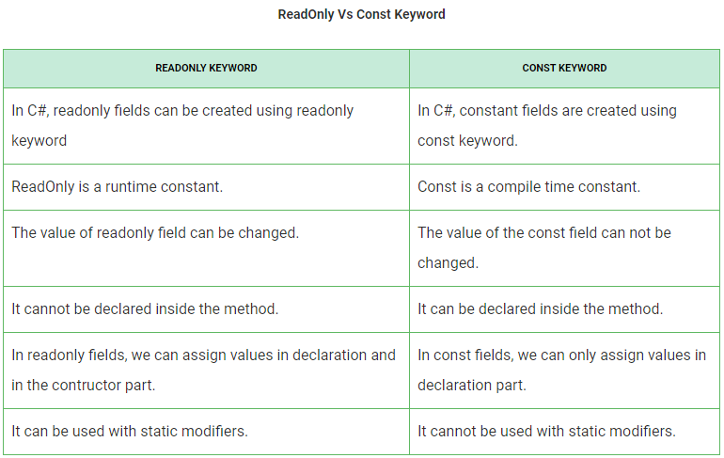
Conversion, Constants & Read-only
Conversion :
Type conversion is converting one type of data to another type. It is also known as Type Casting. In C#, type casting has two forms :-
Implicit type conversion :
These conversions are performed by C# in a type-safe manner. For example, are conversions from smaller to larger integral types and conversions from derived classes to base classes.
Explicit type conversion :
These conversions are done explicitly by users using the pre-defined functions. Explicit conversions require a cast operator.
Constants & Read-only :
Constant :
Constants are immutable values which are known at compile time and do not change for the life of the program. Constants are declared with the const modifier. Only the C# built-in types (excluding System.Object) may be declared as const. Constants can be marked as public, private, protected, internal, protected internal or private protected. These access modifiers define how users of the class can access the constant
Readonly:
It is a keyword to declare a readonly variable. This readonly keyword shows that you can assign the variable only when you declare a variable or in a constructor of the same class in which it is declared.

Slide 29
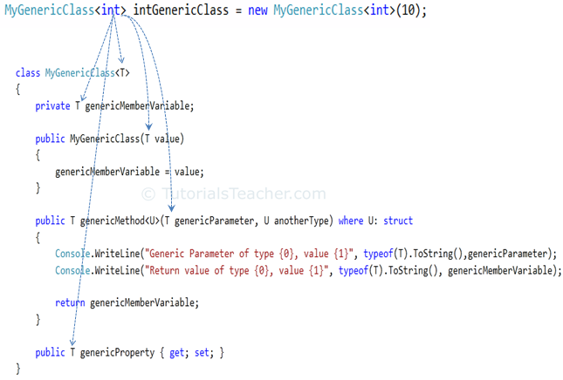
Generics
Generics allow you to define a class with placeholders for the type of its fields, methods, parameters, etc. Generics replace these placeholders with some specific type at compile time.
A generic class can be defined using angle brackets <>.
When deriving from a generic base class, you must provide a type argument instead of the base-class's generic type parameter
Generics can be applied to the following:
Interface
Abstract class
Class
Method
Static method
Property
Event
Delegates
Operator
https://www.tutorialsteacher.com/csharp/csharp-generics

Slide 30
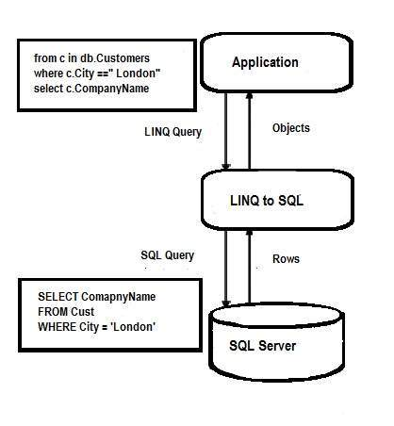
LINQ Operations
A For most ASP.NET developers, LINQ to SQL (also known as DLINQ) is an electrifying part of Language Integrated Query as this allows querying data in SQL server database by using usual LINQ expressions.
It also allows to update, delete, and insert data, but the only drawback from which it suffers is its limitation to the SQL server database. However, there are many benefits of LINQ to SQL over ADO.NET like reduced complexity, few lines of coding and many more.
Querying with LINQ to SQL
The rules for executing a query with LINQ to SQL is similar to that of a standard LINQ query i.e. query is executed either deferred or immediate. There are various components that play a role in execution of a query with LINQ to SQL and these are the following ones.
LINQ to SQL API − requests query execution on behalf of an application and sent it to LINQ to SQL Provider.
LINQ to SQL Provider − converts query to Transact SQL(T-SQL) and sends the new query to the ADO Provider for execution.
ADO Provider − After execution of the query, send the results in the form of a DataReader to LINQ to SQL Provider which in turn converts it into a form of user object.
It should be noted that before executing a LINQ to SQL query, it is vital to connect to the data source via DataContext class.
https://www.tutorialspoint.com/linq/linq_sql.htm

Slide 31
LINQ Operations
Filtering Operators : Filtering is an operation to restrict the result set such that it has only selected elements satisfying a particular condition.
Join Operators : Joining refers to an operation in which data sources with difficult to follow relationships with each other in a direct way are targeted.
Projection Operations : Projection is an operation in which an object is transformed into an altogether new form with only specific properties.
Sorting Operators : A sorting operation allows ordering the elements of a sequence on basis of a single or more attributes.
Grouping Operators : The operators put data into some groups based on a common shared attribute.
Conversions : The operators change the type of input objects and are used in a diverse range of applications.
Concatenation : Performs concatenation of two sequences and is quite similar to the Union operator in terms of its operation except of the fact that this does not remove duplicates.
Aggregation : Performs any type of desired aggregation and allows creating custom aggregations in LINQ.
Quantifier Operations : These operators return a Boolean value i.e. True or False when some or all elements within a sequence satisfy a specific condition.
Partition Operators : Divide an input sequence into two separate sections without rearranging the elements of the sequence and then returning one of them.
Generation Operations : A new sequence of values is created by generational operators.
Set Operations : There are four operators for the set operations, each yielding a result based on different criteria.
Equality : Compares two sentences (enumerable ) and determine are they an exact match or not.
Element Operators : Except the DefaultIfEmpty, all the rest eight standard query element operators return a single element from a collection.
https://docs.microsoft.com/en-us/dotnet/csharp/programming-guide/concepts/linq/basic-linq-query-operations

Slide 32




THANK YOU
HEAD OFFICE:
B/81, Corporate House, Judges Bunglow Road,
Bodakdev, Ahmedabad - 380054. India.
+91 79 2685 2554 / 55 / 56
gateway@thegatewaycorp.com
WWW.THEGATEWAYCORP.COM

